Slide 1
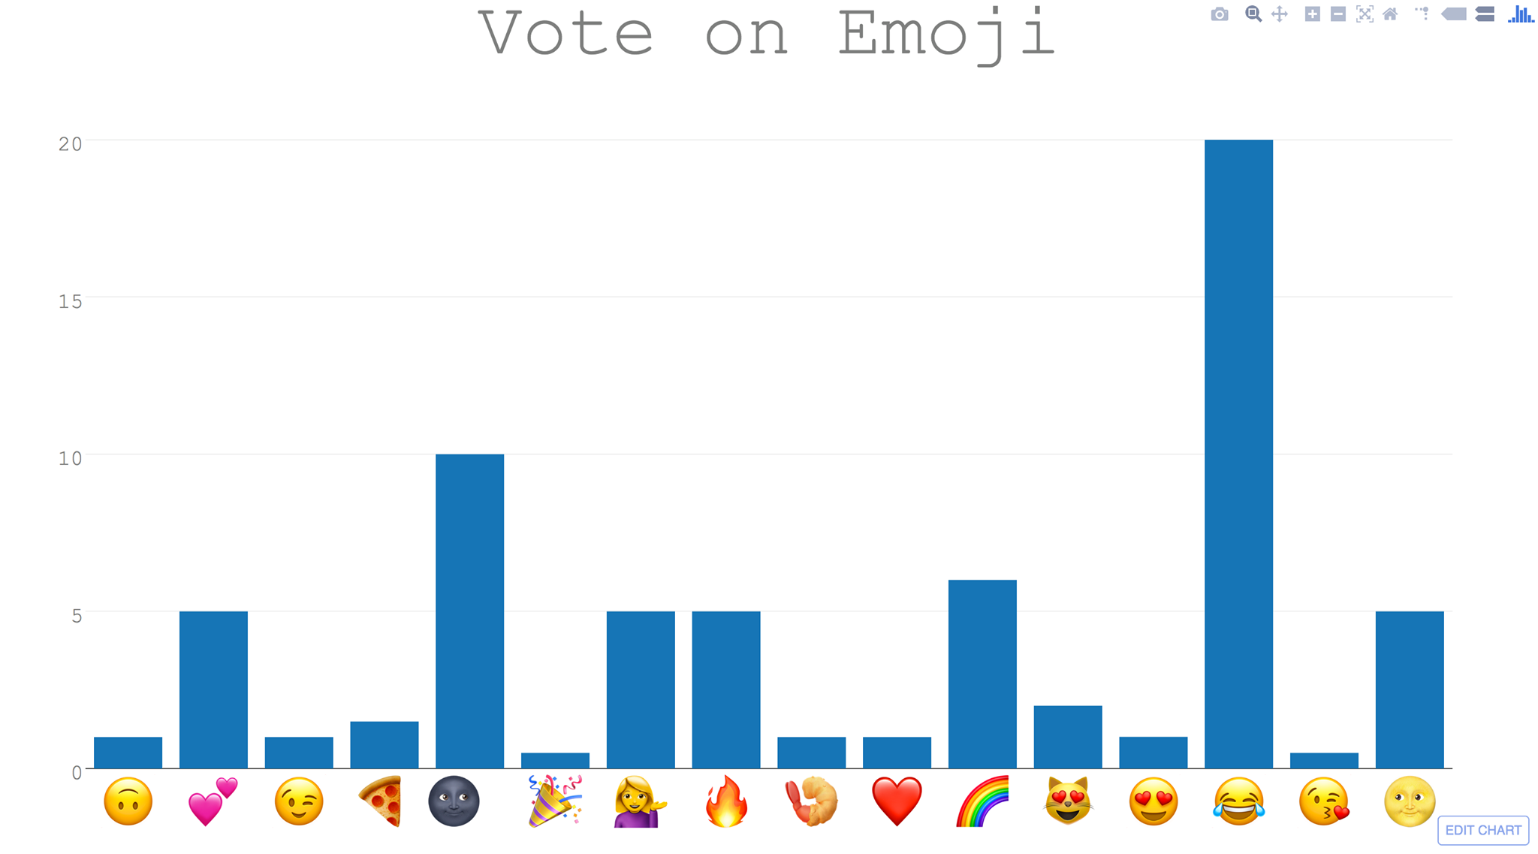
Using the Appeal of Emoji to Increase Donations for Mental Health Awareness Samantha Greenberg, Olivia Kisker, & Sam Turecamo Syracuse University, Syracuse, NY
IST256: Applications Programming for Information Systems
Final Project
Problem
How it Works
Example
How do we raise money in a creative way for suicide prevention and mental health awareness?
The amount of the donation and emoji are added to a graph
Finally, the program prints a bar graph. The height of the bars illustrate the amount of money donated for each emoji
Venmo sends an email when a payment is received
Our code reads the email and extracts the amount of the donation and the emoji
Solution
Venmo is a popular way to make payments and is also a form of social media
Users can attach captions to their payments that friends can read, like, and comment on
Venmo could be used to collect donations for suicide prevention/ mental health awareness
Users could be encouraged to put an emoji in their caption
To get people interested in the campaign, our program plots the emoji to show which emoji is the favorite of the donators
Donations
Emoji

